Slide 1

Hematocrit (Hct) (Packed cell Volume) (PCV)
Prof. Dr. Muna Hameed Al- Saeed

Slide 2
Hct/ PCV
Objective:
To pack the RBC using the microcentrifuge force.
Forcing all red cell below and plasma above, by centrifugal force.

Slide 3
Definition of Hct
The percentage by volume of packed red blood cells in a given sample of blood after centrifugation

Slide 4
Purpose for doing the Hct
Blood is made up of red and white blood cells, platelet and plasma.
A decrease in the number or size of red cells also decreases the amount of space they occupy, resulting in a lower hematocrit.
An increase in the number or size of red cells increases the amount of space they occupy, resulting in a higher hematocrit.

Slide 5
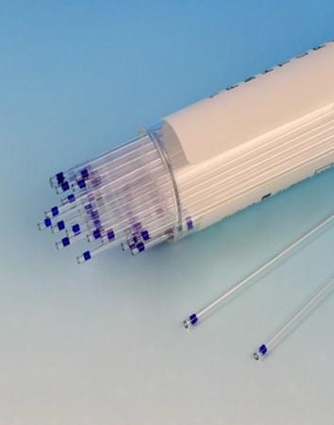
Procedure
1. Capillary tube is used
2. The capillary is filled with blood to half of the tube , but not filled too much.

Slide 6

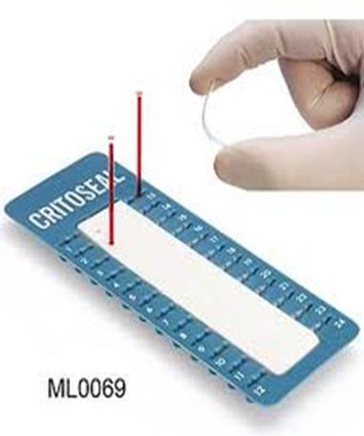
3. Sealing the capillary with clay (cement)
.

Slide 7
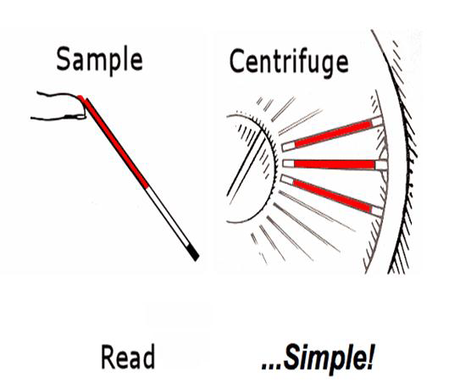
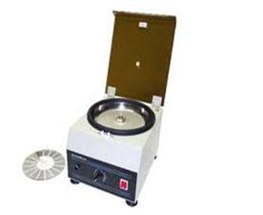
4. Centrifugation (10000 rpm ad two minute)

Slide 8
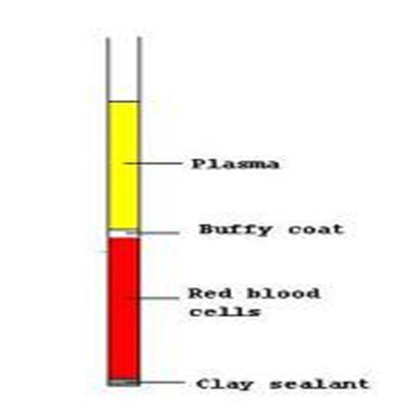
5. Reading the Hct By Ruler
PCV (Hct)= Height of RBC column (cm) x 100
Total Height of blood column(cm)
Result
Result
Female :36-46
Male :40-54
At birth :44-54

Slide 9
Factors affecting the Hct
Speed of centrifuge
Ideal speed approximately 10000 rpm for two minutes.
•Higher than ideal speed ( rpm)-leads to Insufficient packing
Falsely Higher volume of RBC Falsely Lower Hct
•Lower than ideal speed ( rpm)--leads to Lysis of RBC-- Lower RBc volume Falsely higher Hct

Slide 10
2.Time of centrifugation
Under centrifugation:
Time insufficient packing of RBC
Falsely higher Hct.
Over centrifugatiuon:
Time RBC lysis- Falsely lower Hct.

Slide 11
3. Proper sealing
Improper sealing:
1- Big hole-- leaking of whole blood and empty the capillary while centrifuged.
2- Very small hole (unseen by eye)-- causes small leak that only affects the RBC volume because it closer to the sealing-- falsely low RBC volume- low Hct.

Slide 12
4. Biological factors
Trapped plasma
1. In normal condition:
•There is a small per cent of plasma which is trapped with the packed RBC, approximately 2-3%.
•E.g. 43 is actually 40 by considering the 3% of plasma, but it is always be ignored as it is negligible.

Slide 13
2. In pathological condition:
•The per cent of trapped plasma may increased, reaching to 10% , and thus leads to high RBC volume and ultimately leads to high Hct.

Slide 14
Medical advantage of Hct
The hematocrit is used to screen for anaemia, or is measured on a person to determine the extent of anaemia
A result within reference range doesn’t necessary mean that patient is not anaemic, and vice versa.
Haemoglobin concentration is more significant for anaemia diagnosis.

Slide 15
Important Reminders
Some students didn’t wright their name and no reported result for them.
Always write your name in the upper left corner With the number of lab under it
Please always use proper A4 size paper and not a notebook.
No one will be signed for attendance except after I see her clean place in the lab, unclean bench will reduce your mark.

